Slide 1

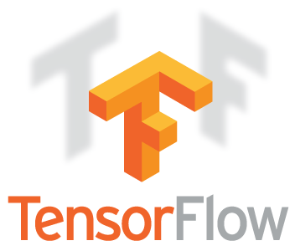
TensorFlow Introduction: Duke-Tsinghua Machine Learning Summer School 2017
Kevin Liang
Duke University – Electrical and Computer Engineering
26 July 2017

Slide 2
TensorFlow: What is it?
A software library for machine learning
Computation using data flow graphs
Neural Networks
Released by Google November 9, 2015
An open source successor to DistBelief
Apache 2.0 License
APIs:
Python
C++
Java
Go

Slide 3
TensorFlow: Alternatives
Caffe
UC Berkeley (BVLC: Berkeley Vision and Learning Center)
Microsoft Cognitive Toolkit (CNTK 2.0)
Microsoft
Theano
Université de Montréal (MILA/LISA: Montreal Institute for Learning Algorithms)
Torch

Slide 4
TensorFlow: Why?
CPU/GPU/TPU support, easy to scale up
Large and active user-base
Academia, industry, enthusiasts
Rapid Development and support by Google
TensorBoard visualizations
Integration with Google Cloud Platform
Pre-trained models and high-level libraries (Slim, Keras, TFLearn)

Slide 5
TensorFlow: Data Flow Graphs

Slide 6
TensorBoard: Graph Visualization

Slide 7
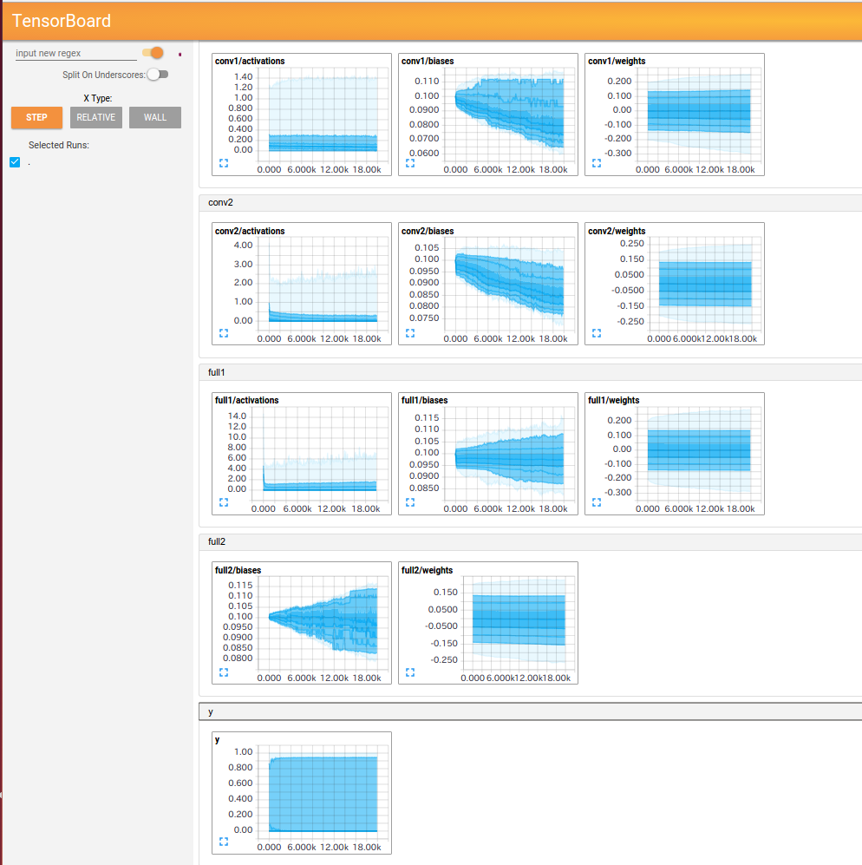
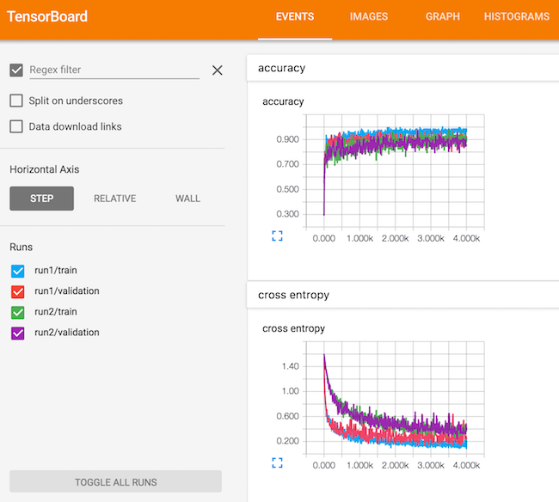
TensorBoard: Monitor Training

Slide 8
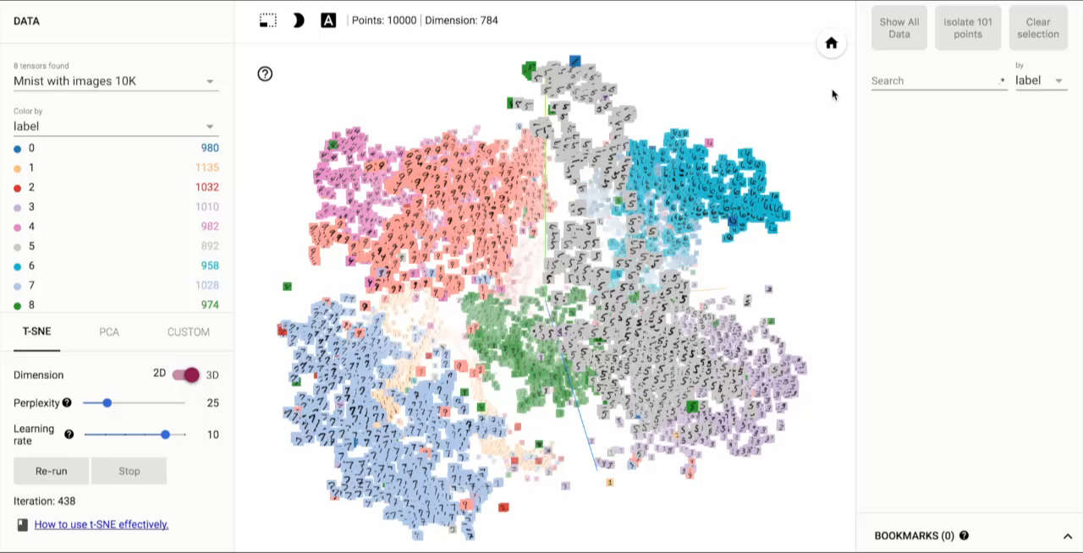
TensorFlow: Data Flow Graphs

Slide 9
Questions?

